Slide 1
Bayesian Subtree Alignment Model based on Dependency Trees
Toshiaki Nakazawa Sadao Kurohashi
Kyoto University
2011/11/11 @ IJCNLP2011

Slide 2
Outline
Background
Related Work
Bayesian Subtree Alignment Model
Model Training
Experiments
Conclusion

Slide 3
Background
Alignment quality of GIZA++ is quite insufficient for distant language pairs
Wide range reordering, many-to-many alignment
Fr: Il est mon frère .
En: He is my bother .
Zh: 他 是 我 哥哥 。
Ja: 彼 は 私 の 兄 です 。

Slide 4
Alignment Accuracy of GIZA++
with combination heuristic
Language pair | Precision | Recall | AER
French-English | 87.28 | 96.30 | 9.80
English-Japanese | 81.17 | 62.19 | 29.25
Chinese-Japanese | 83.77 | 75.38 | 20.39
Sure alignment: clearly right
Possible alignment: reasonable to
make but not so clear
Automatic (GIZA++) alignment

Slide 5
Background
Alignment quality is quite insufficient for distant language pairs
Wide range reordering, many-to-many alignment
English-Japanese, Chinese-Japanese > 20% AER
Need to incorporate syntactic information
Fr: Il est mon frère .
En: He is my bother .
Zh: 他 是 我 哥哥 。
Ja: 彼 は 私 の 兄 です 。

Slide 6
Related Work
Cherry and Lin (2003)
Discriminative alignment model using source side dependency tree
Allows one-to-one alignment only
Nakazawa and Kurohashi (2009)
Generative model using both side dependency trees
Allows phrasal alignment
Degeneracy of acquiring incorrect larger phrases derived from Maximum Likelihood Estimation

Slide 7
Related Work
DeNero et al. (2008)
Incorporate prior knowledge about the parameter to void the degeneracy of the model
Place Dirichlet Process (DP) prior over phrase generation model
Simple distortion model: position-based
This work
Take advantage of two works by Nakazawa et al. and DeNero et al.

Slide 8
Related Work
[DeNero et al., 2008]
Generative story of (sequential) phrase-based joint probability model
Choose a number of components
Generate each of phrase pairs independently
Nonparametric Bayesian prior
Choose an ordering for the phrases
Model
Step 1
Step 3
Step 2

Slide 9
Example of the Model
Step 1
Step 3
Step 2
He
C₁
彼 は
is
C₂
です
my
C₃
私 の
brother
C₄
兄
Simple position-based distortion

Slide 10
Proposed Model
Step 1
Step 3
Step 2
彼
He
C₁
は
is
C₂
です
私
my
C₃
の
brother
C₄
兄
Dependency Tree-based distortion

Slide 11
Bayesian Subtree Alignment Model
based on Dependency Trees

Slide 12
Model Decomposition
Null
Non-null
dependency of phrases
dependency relations
cf. [DeNero et al., 2008]

Slide 13
Dependency Relations
彼
He
は
is
私
my
の
borther
兄
です
# of steps for going up
rel(“He”, “is”)
= (Up, Down) = (1, 0)
rel(“brother”, “is”) = (1, 0)
# of steps for going down
rel(“my”, “brother”) = (1, 0)

Slide 14
Dependency Relations
彼
He
は
is
私
my
の
borther
兄
です
rel(“彼 は”, “です”) = (1, 0)
rel(“私 の”, “兄”) = (1, 0)
rel(“兄”, “です”) = (1, 0)

Slide 15
Dependency Relations
NULL
彼女
She
は
has
髪
long
が
hair
長い
rel(“long”, “hair”) = (0, 1)
rel(“hair”, “she has”) = (1, 2)
rel(“髪 が”, “長い”) = (0, 1)

Slide 16
Dependency Relations
NULL
彼女
She
は
has
髪
long
が
hair
長い
rel(“彼女”, “は”) = ？
rel(“彼女”, “長い”) = (0, 2)
N(“彼女”) = 1
# of NULL words on the way to non-null parent

Slide 17
Dependency Relation Probability
Assign probability to the tuple: p(R_{e} = (N, rel) = (N, Up, Down)) ～
Reordering model is decomposed as:

Slide 18
Model Training

Slide 19
Model Training
Initialization
Create heuristic phrase alignment like ‘grow-diag-final-and’ on dependency trees using results from GIZA++
Count phrase alignment and dependency relations
Refine the model by Gibbs sampling
Operators: SWAP, TOGGLE, EXPAND

Slide 20
SWAP Operator
Swap the counterparts of two alignments
SWAP-1
・・・
・・・
・・・
・・・
SWAP-2
NULL
・・・
・・・
NULL

Slide 21
TOGGLE Operator
Remove existing alignment or add new alignment
TOGGLE
NULL
NULL

Slide 22
EXPAND Operator
Expand or contract an aligned subtree
EXPAND-1
NULL
EXPAND-2
NULL

Slide 23
Alignment Experiment
Training: 1M for Ja-En, 678K for Ja-Zh
Testing: about 500 hand-annotated parallel sentences (with Sure and Possible alignments)
Measure: Precision, Recall, Alignment Error Rate
Japanese Tools: JUMAN and KNP
English Tool: Charniak’s nlparser
Chinese Tools: MMA and CNP (from NICT)

Slide 24
Alignment Experiment
Ja-En (paper abstract: 1M sentences)
 | Precision | Recall | AER
Initialization | 82.39 | 61.82 | 28.99
Proposed | 85.93 | 64.71 | 25.73
GIZA++ & grow | 81.17 | 62.19 | 29.25
Berkeley Aligner | 85.00 | 53.82 | 33.72

Slide 25
Alignment Experiment
Ja-Zh (technical paper: 680K sentences)
 | Precision | Recall | AER
Initialization | 84.71 | 75.46 | 19.90
Proposed | 85.49 | 75.26 | 19.60
GIZA++ & grow | 83.77 | 75.38 | 20.39
Berkeley Aligner | 88.43 | 69.77 | 21.60

Slide 26
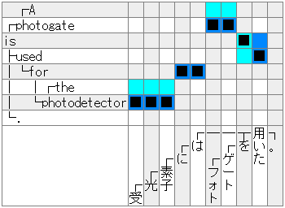
Improved Example
GIZA++
Proposed

Slide 27
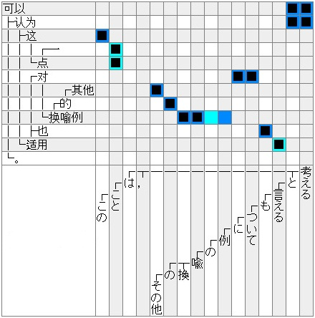
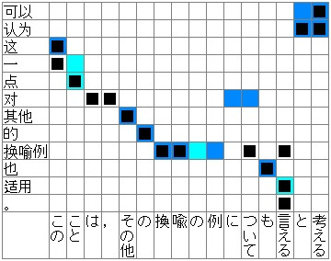
Proposed
GIZA++

Slide 28
Proposed
GIZA++

Slide 29
Japanese-to-English Translation Experiment
Baseline: Just run Moses and MERT

Slide 30
Japanese-to-English Translation Experiment
Initialization: Use the result of initialization as the alignment result for Moses

Slide 31
Japanese-to-English Translation Experiment
Proposed: Use the alignment result of proposed model after few iterations for Moses

Slide 32
Proposed
GIZA++

Slide 33
Conclusion
Bayesian Tree-based Phrase Alignment Model
Better alignment accuracy than GIZA++ in distant language pairs
Translation
Currently (temporally), not improved ☹
Future work
Robustness for parsing errors
Using N-best parsing result or forest
Show improvement in translation
Tree-based decoder(, Hiero?)

